Slide 1
Discrete Elastic Rod Simulation of Shoelace Knots and Strength
Midterm Update
Esther Gérard, Evelyn Kim, Noah Shamsai

Slide 2
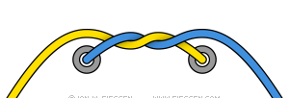
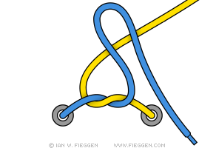
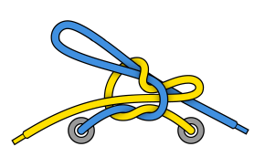
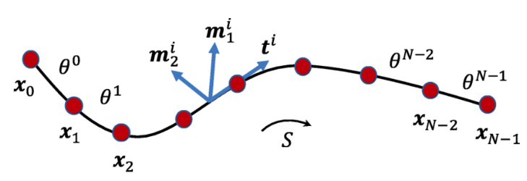
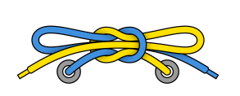
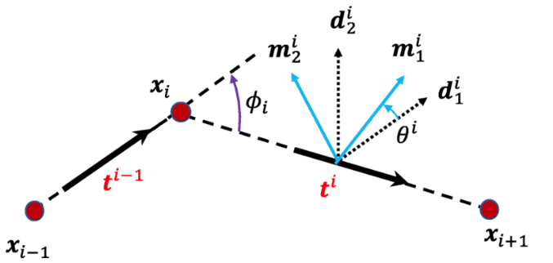
Review of Problem
Discrete Elastic Rods (DER) algorithm with Implicit model
Tying & Untying the knot
Measuring force required to untie reef knot
Effects of shoelace stiffness and friction on knot strength
https://www.fieggen.com/shoelace/standardknot.htm
https://images.app.goo.gl/grqPd8ZQ2AxtSE9i9

Slide 3
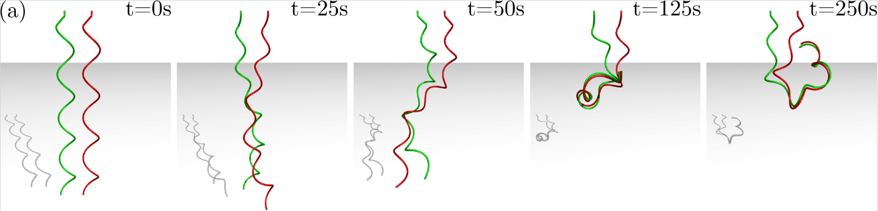

Current Progress
Base
https://github.com/StructuresComp/rod-contact-sim
Video
Parameters
Rod radius: 1.6mm
E: 0.18MPa
Poisson: 0.5
dt: 0.01s
tol: 0.001
No gravity, no fluid friction

Slide 4
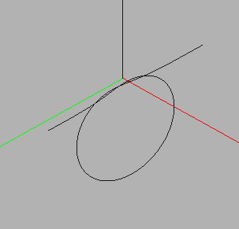
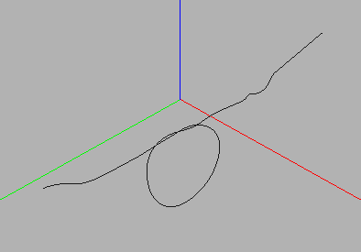
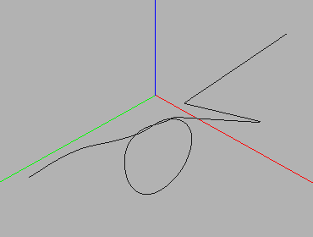
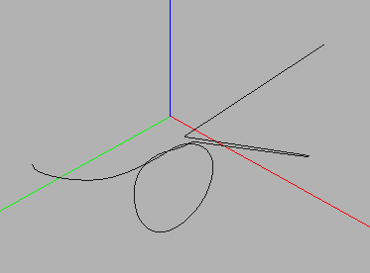
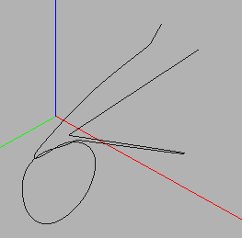
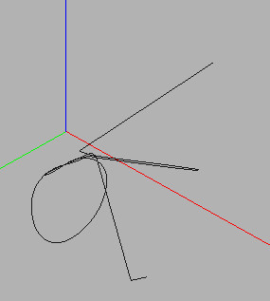
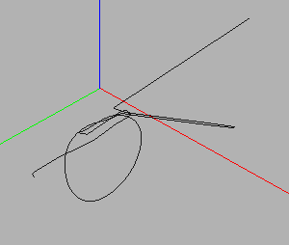
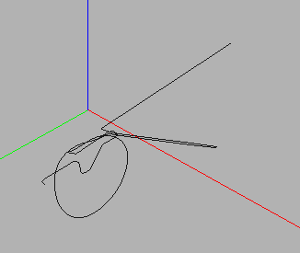
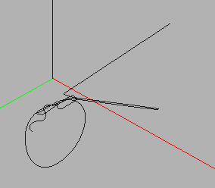
Steps
0
1
2
3
3
3
4
5
6

Slide 5
Challenges
Identifying successive boundary conditions in displacement to correctly form the knot
Avoid storing too much internal energy
Current challenge: release the previously fixed nodes correctly to obtain a tied reef knot (final step)

Slide 6

Future Plan
Obtain the tied reef knot
Simulate and record the untying
Implementation and comparison to granny knot (which is very similar to reef, the third step has to be done in the opposite direction)
Comparison of model parameters and knot strength
Reef
Granny
Pictures from https://www.fieggen.com/shoelace/grannyknot.htm

Slide 7
Thank you! Questions?

